Slide 1

Group 8
Sprint Update
Tranquility Tribe

Slide 2
Content
Entity Relationship Diagram Development
Database Building
Frontend Development

Slide 3
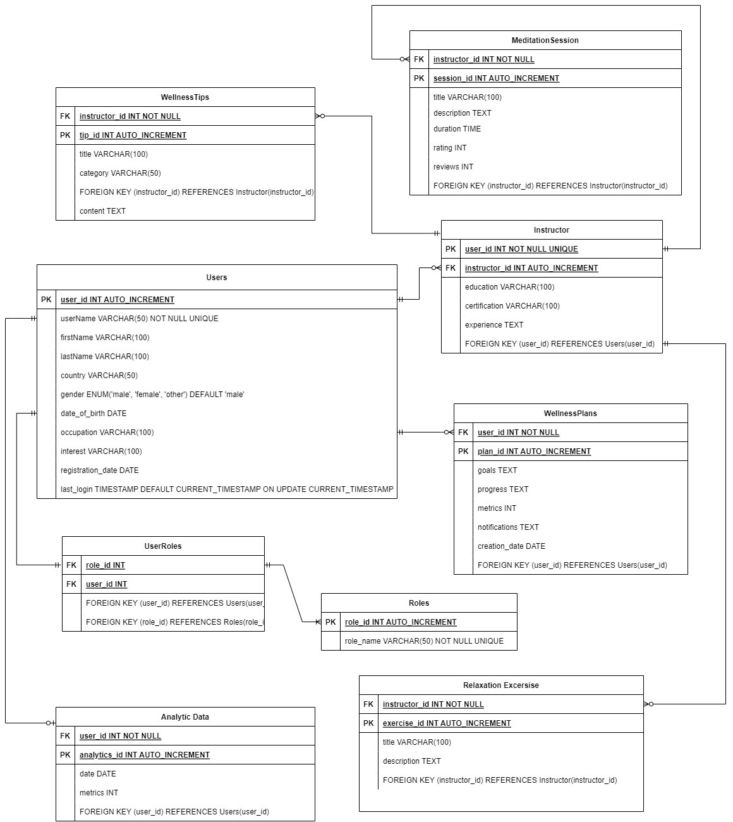
ER-Diagram

Slide 4
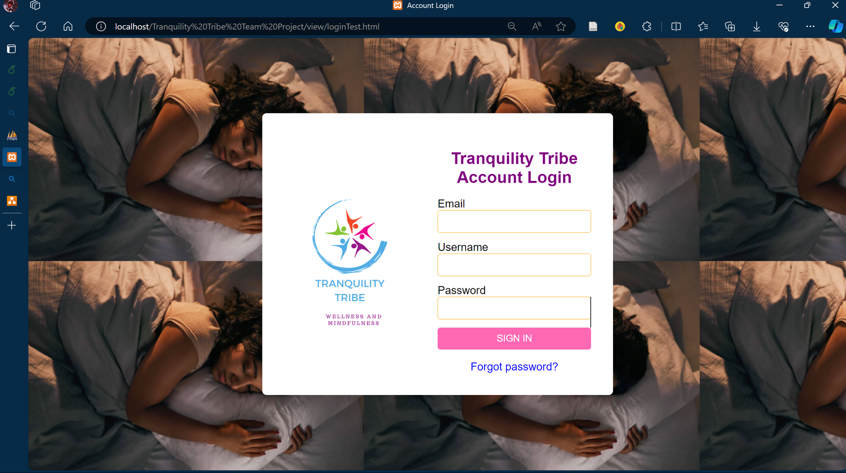
Login Page
link

Slide 5

About Page
link

Slide 6
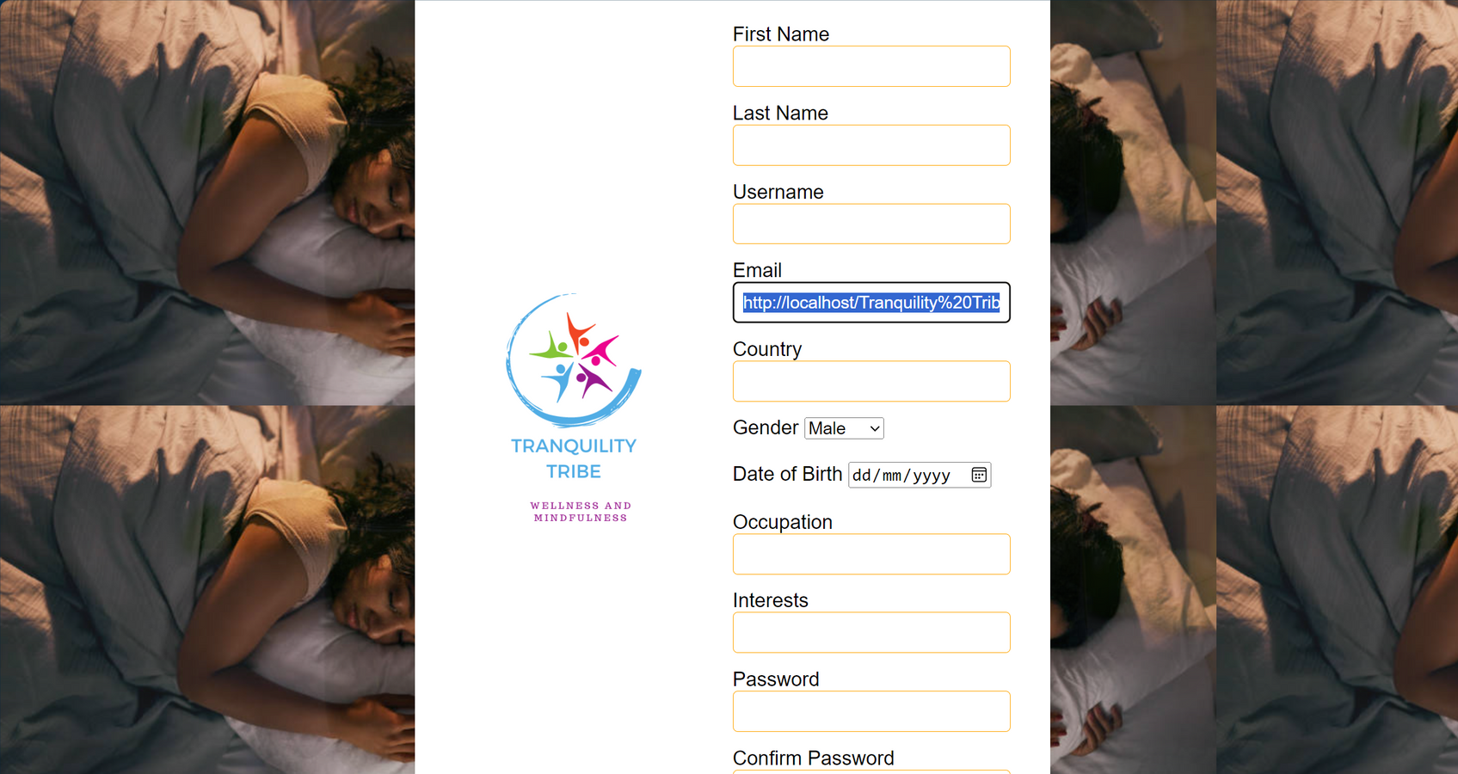
Login Page
link

Slide 7
Thank You!!!

